Slide 1



Kinetic Theory of Decentralized Learning for Smart Active Matter
Gerhard Jung , Misaki Ozawa , and Eric Bertin
​​Phys. Rev. Lett. 134, 248302 (2025）
曹溪能

Slide 2
内容回顾

Slide 3
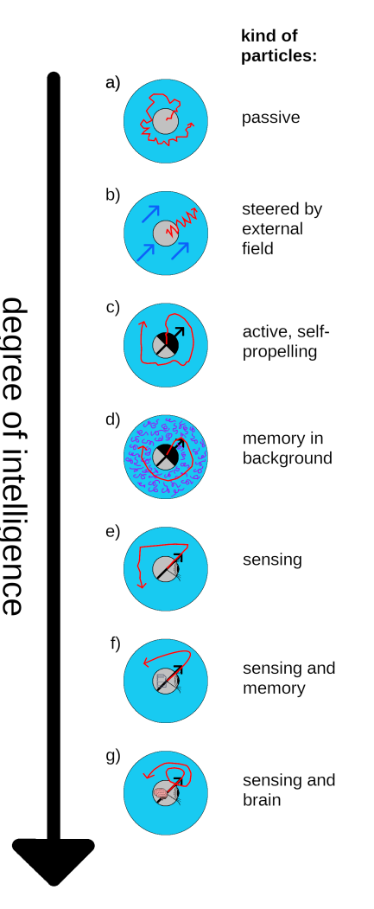
background:smart active particle
“smart active particle” in this article is at “g” level:
sense its neighbors,memory,make and change policy
Löwen H, Liebchen B. Towards intelligent active particles[J]. arXiv preprint arXiv:2501.08632, 2025.

Slide 4
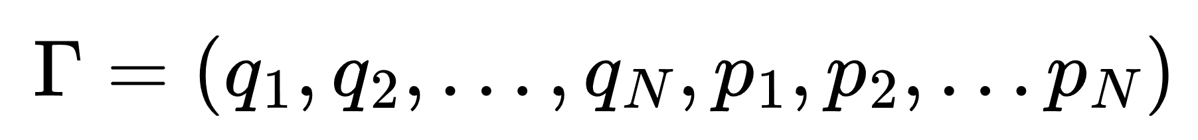
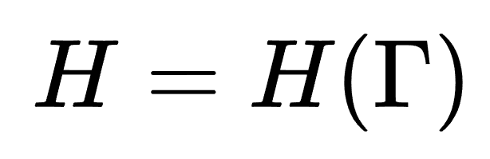
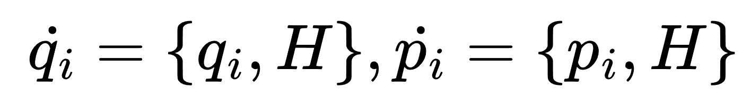
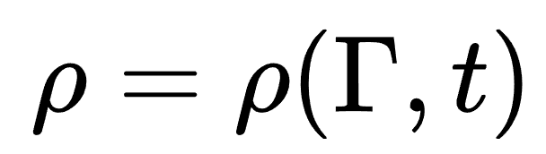
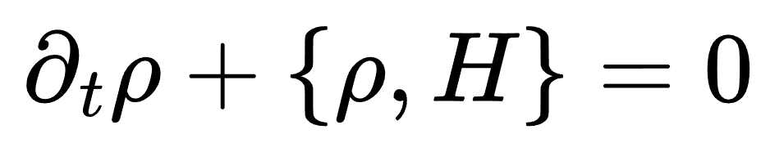
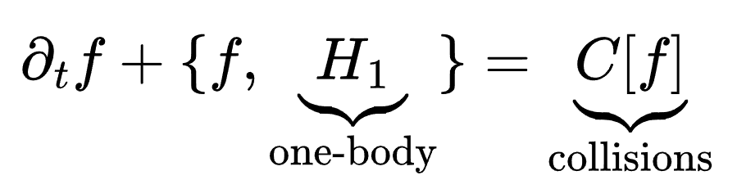
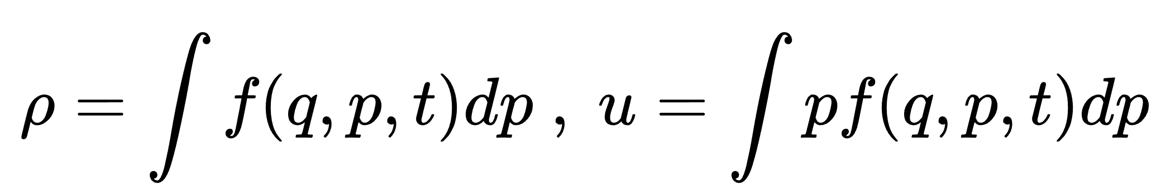
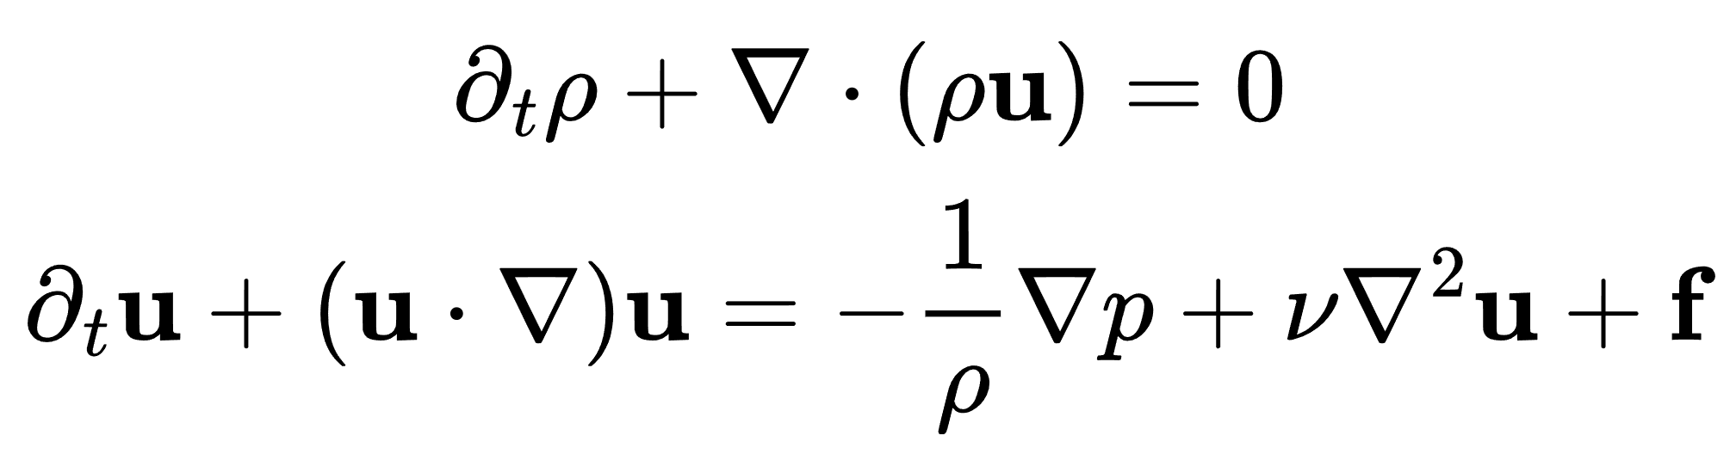
background:what is kinetic theory?
kinetic theory:
solve the distribution function in phase space
6N dimension
microscopic
Hamilton equation
dynamic theory
Liouville equation
mesoscopic
boltzman equation
macroscopic
hydrodynamic equation

Slide 5
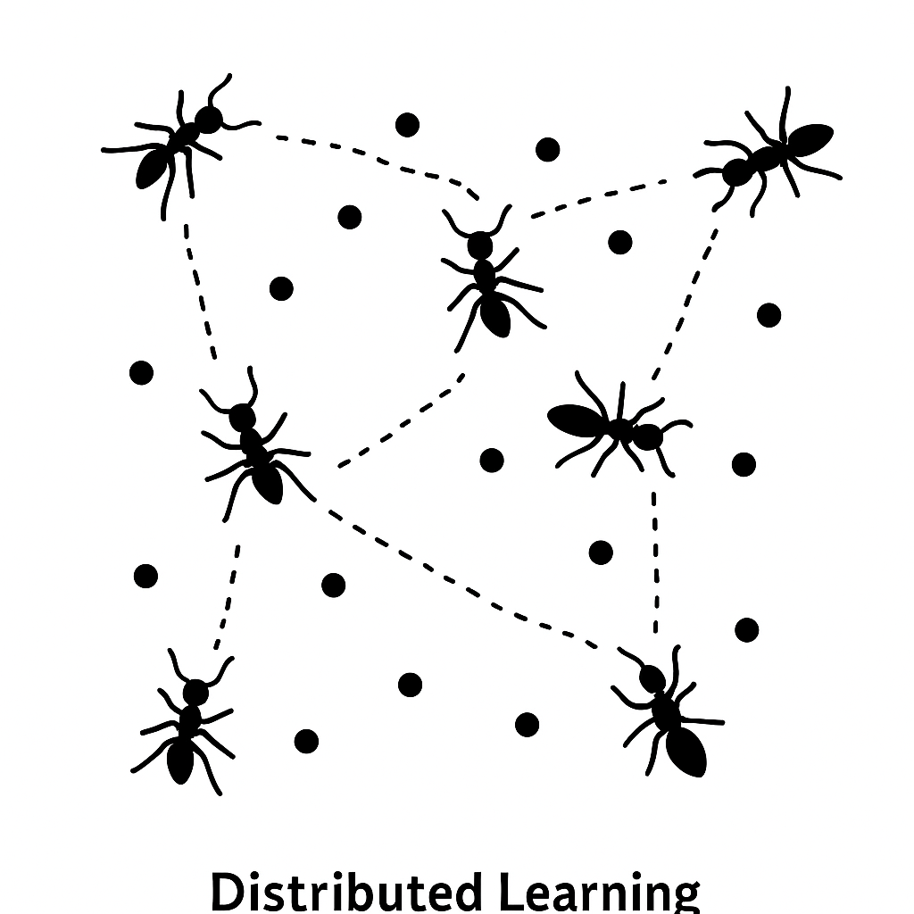
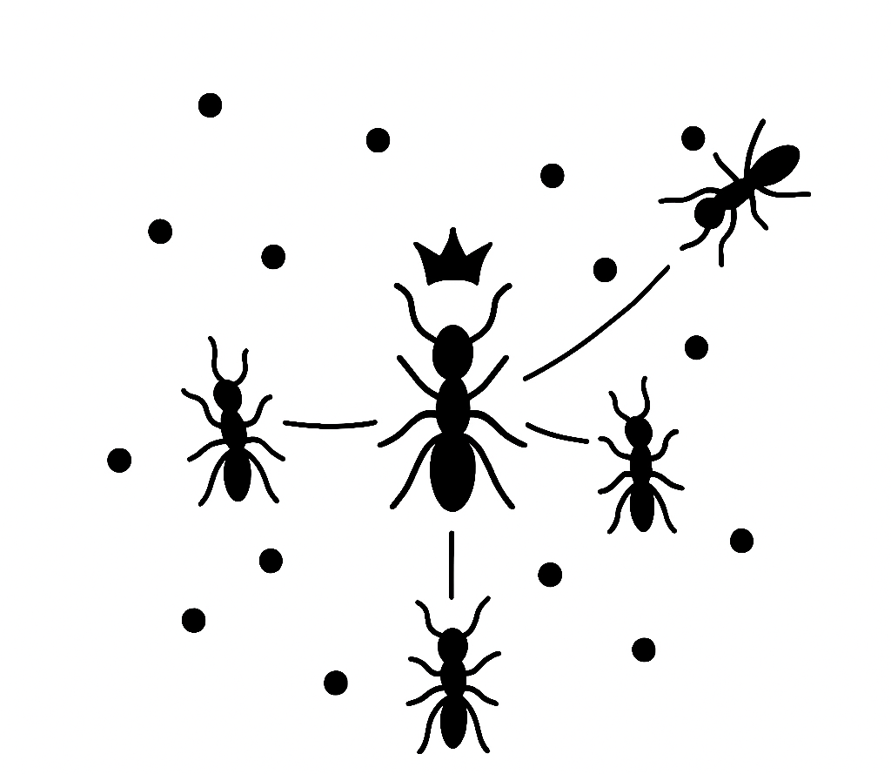
background :decentralized learning
what is learning?
have a target and change its parameters to try to realize the target
what is decentralized learning?
decentralized learning
for each agent,update their parameters using only local data and neighbor interactions,no central controller
centralized learning
generated by gpt

Slide 6
background :decentralized learning
Does this paper’s research belong to machine learning?
No,it’s the research paradigm of kinetic theory in physics,not the paradigm of machine learning
Why do we feel that this article is related to machine learning?
One perspective: The article borrows some concepts from reinforcement learning, such as policy and reward function, and decentralized learning also exists in reinforcement learning.
More comparisons between this article and “decentralized learning Multi-Agent Reinforcement Learning” will be introduced after this article.

Slide 7
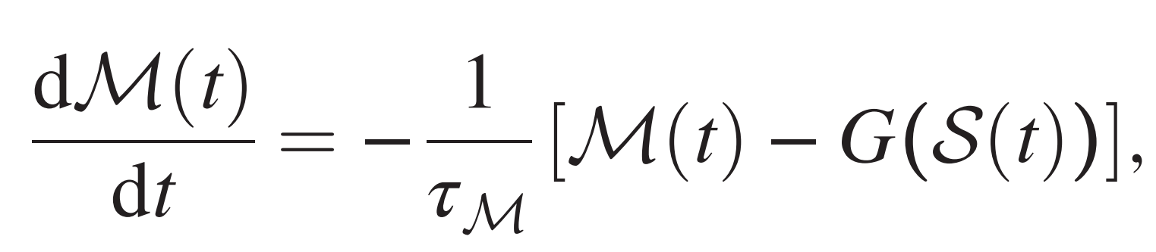
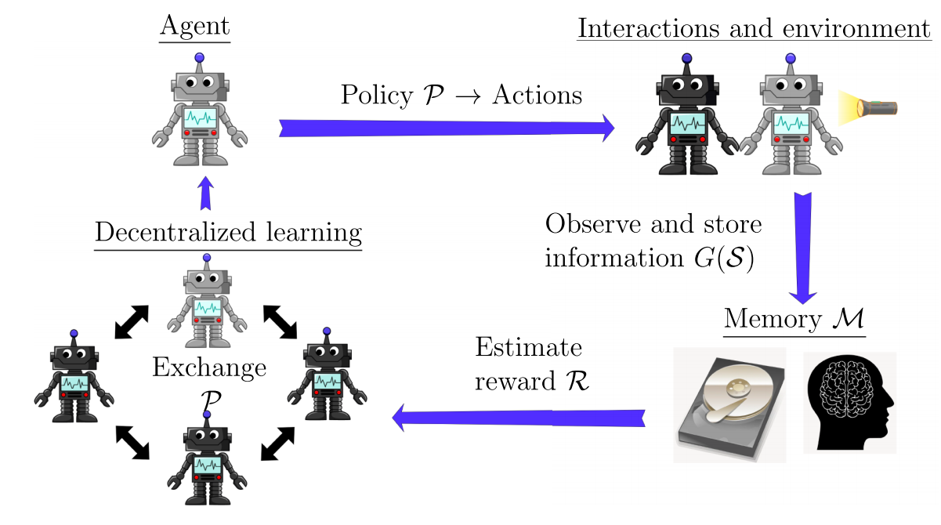
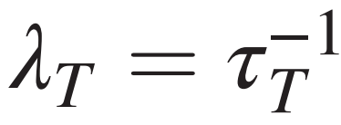
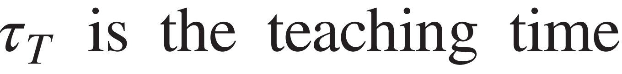
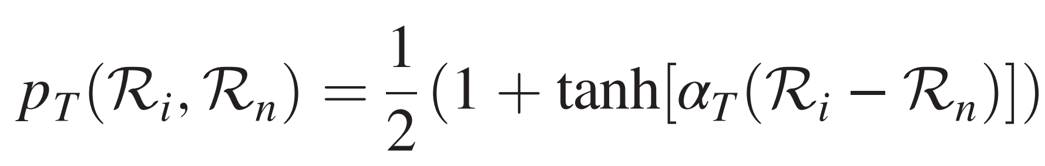
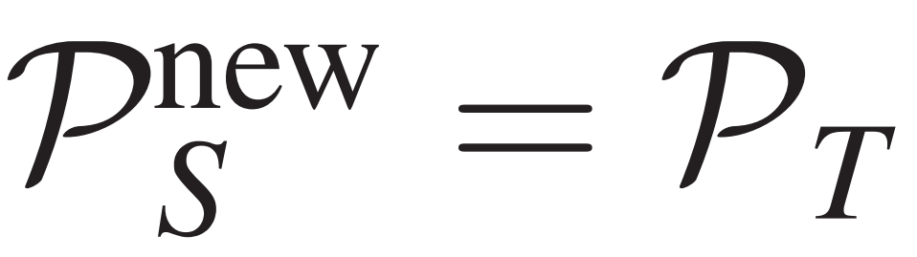
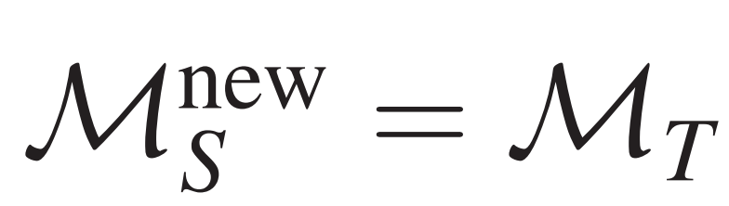
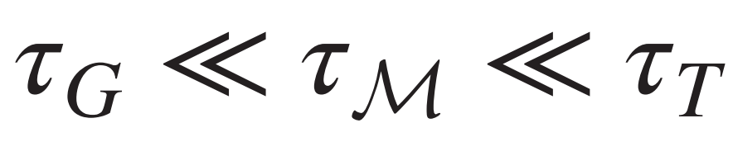
model:Agent-based model of decentralized learning
what is an agent?
position x,overdamped velocity v,position diffusivity D
state S:internal physical variables e.g.,orientation, self-propulsion velocity
policy P:parameters that agent can change e.g.,angular diffusion coefficient
processed information G(s),and memory M:
decentralized learning procedure:
teaching and learning at rate
i become a teacher at the possibility
student copy teacher’s policy and memory
add mutation in policy space,with diffusion coefficient $D_{mut}$
time scale separation
(time scale of S≪M ≪P)

Slide 8
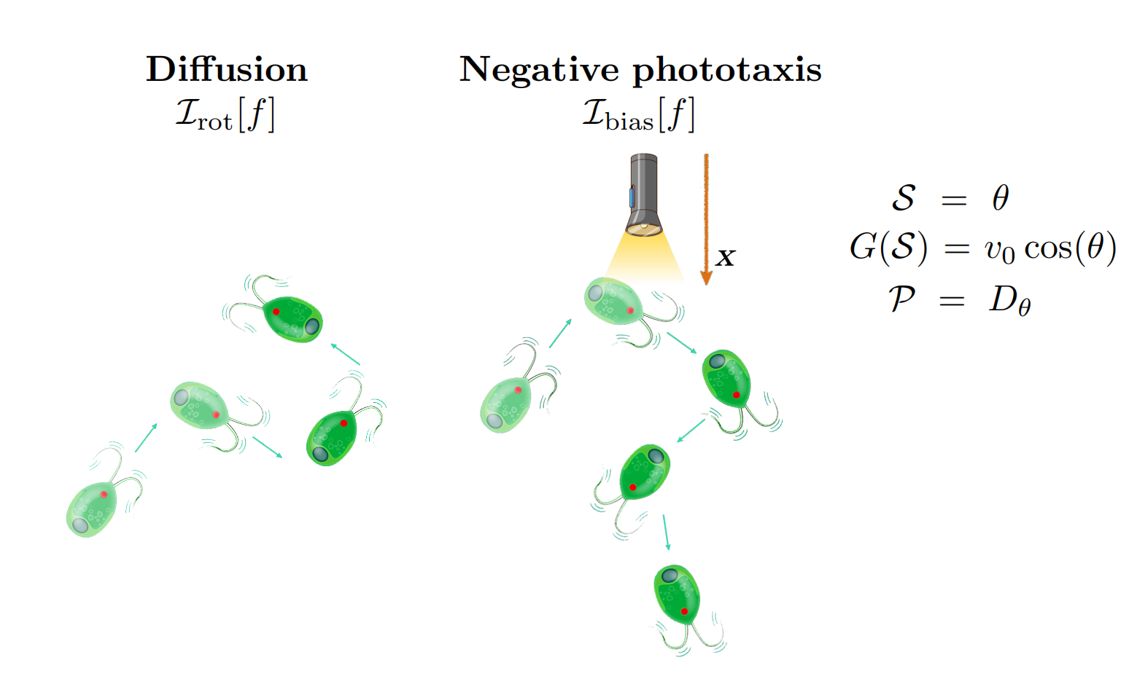
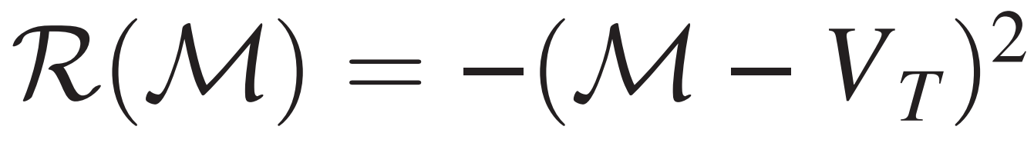
model：one example
Phototactic, diffusive agents
$V_{T}$ is constant

Slide 9
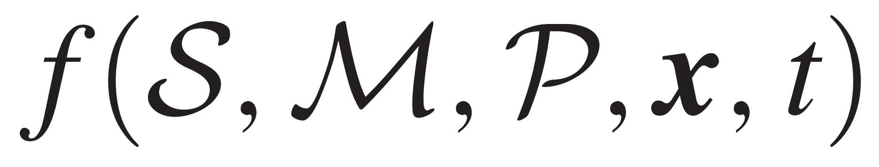
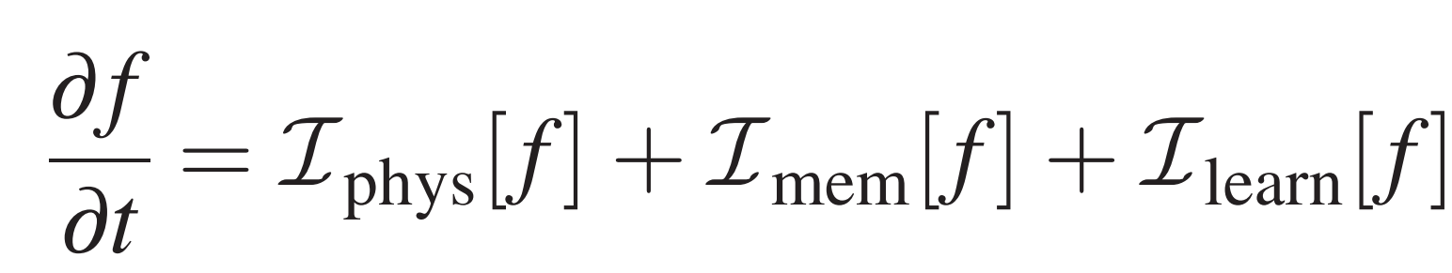
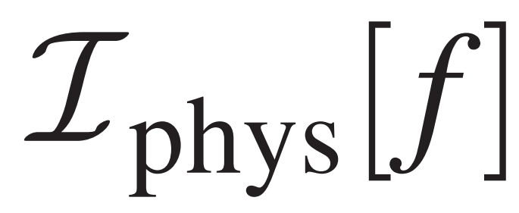
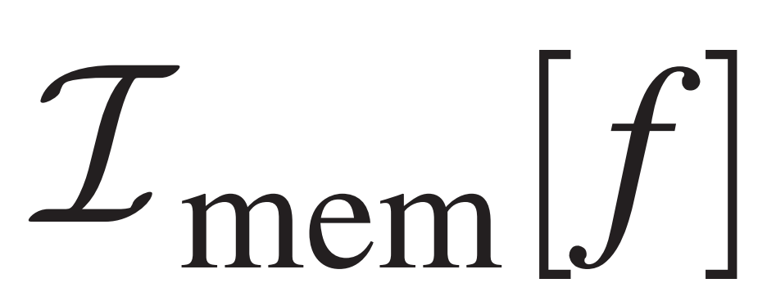
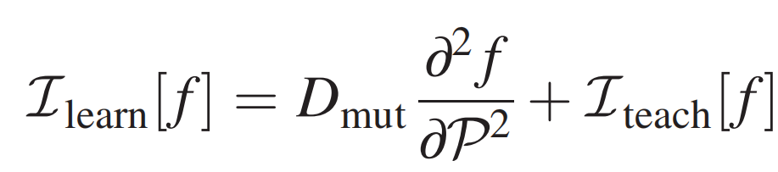
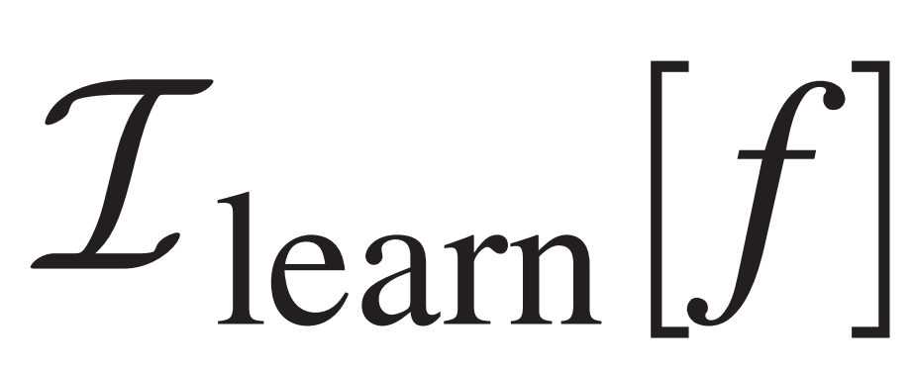
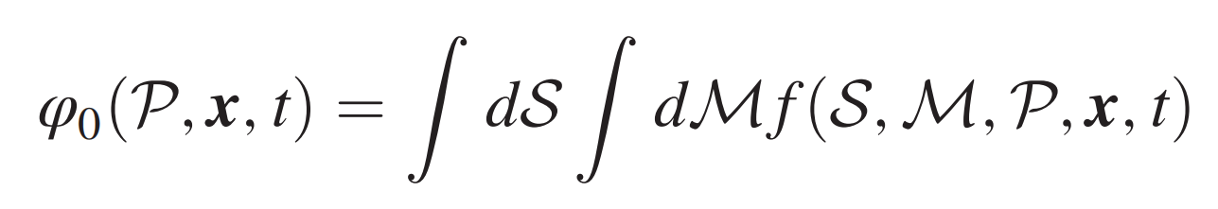
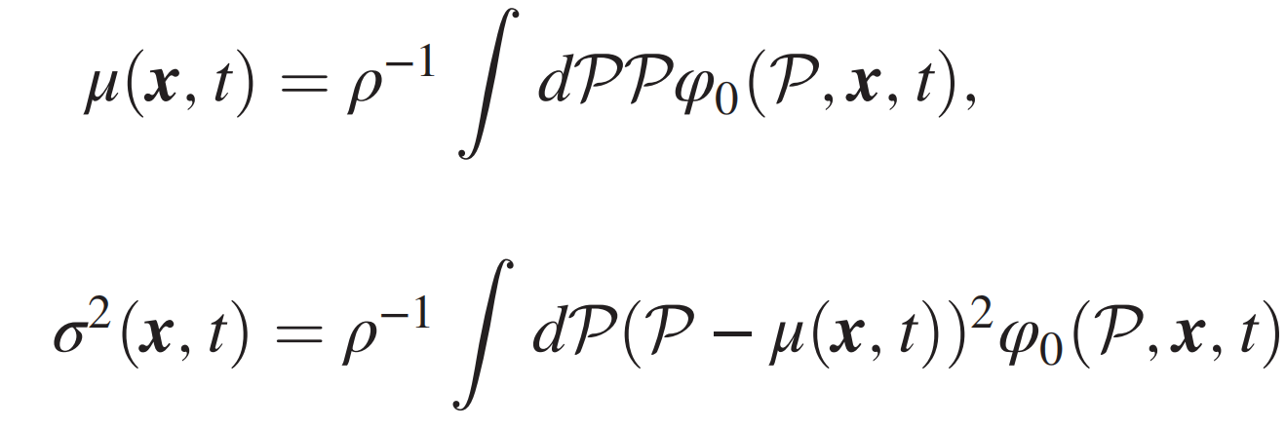
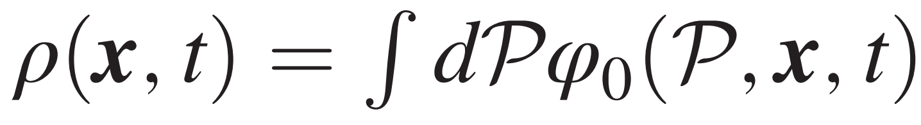
kinetic theory
single-agent phase-space density
equation
physical dynamic of the state S and the position x
memory dynamic of M
policy dynamic of P
time scale separation
(time scale of S≪M ≪P)
we want to get the hydrodynamic of policy(its mean and variance)
Integrate over slow variables S and M
Obtain P’s hydrodynamic equations $μ(x,t)$,$σ^{2}(x,t)$
where

Slide 10
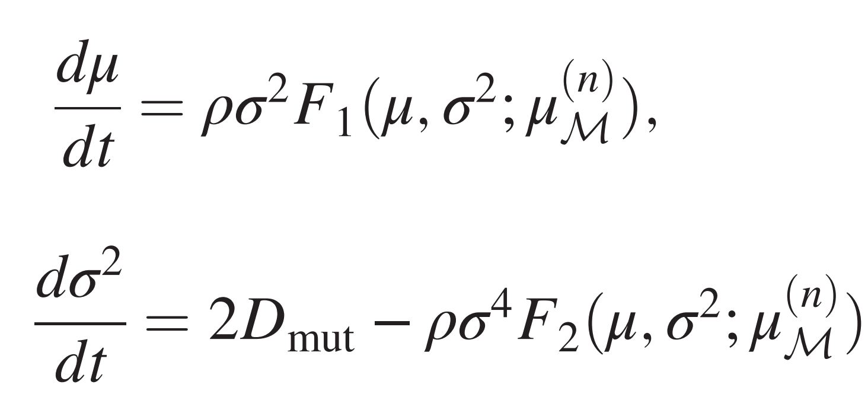
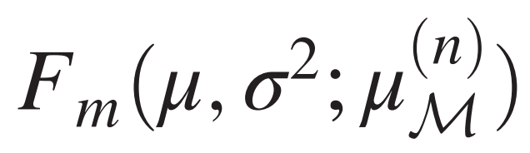
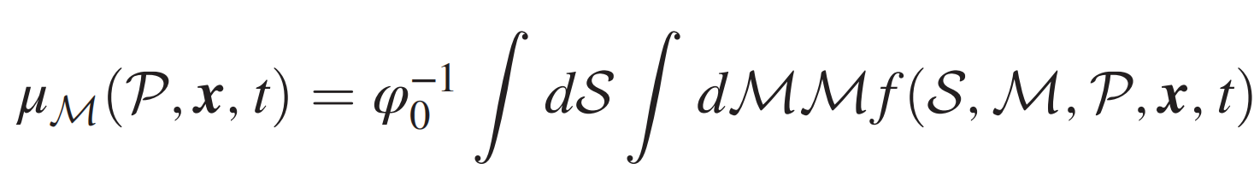
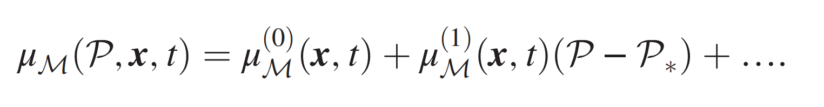
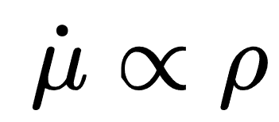
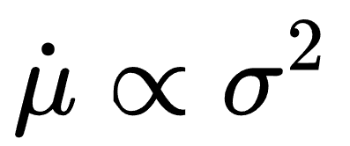
kinetic theory:framework and results
P’s hydrodynamic equations $μ(x,t)$,$σ^{2}(x,t)$
(detailed derivation see SI)
with m = 1, 2 are model-specific polynomials
remarks and nontrivial conclusions:
1. “physical” parameters lie in
, “memory” parameters lie in
, because of timescale separation
2. the higher the density, the faster the evolution.
3. consistent with fisher’s fundamental theorem of natural selection
4. on timescale t≫$τ_{m}$, we have $F_{2}>0$. the variance will decay to 0 in the absence of $D_{mut}$ . $D_{mut}$ act as driven force, break detailed balance and maintain the diversity

Slide 11
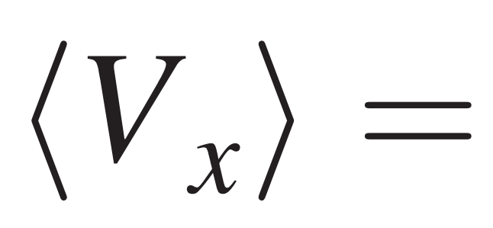
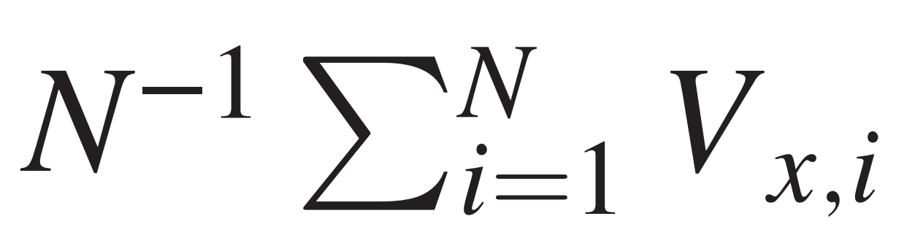
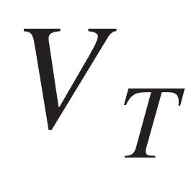
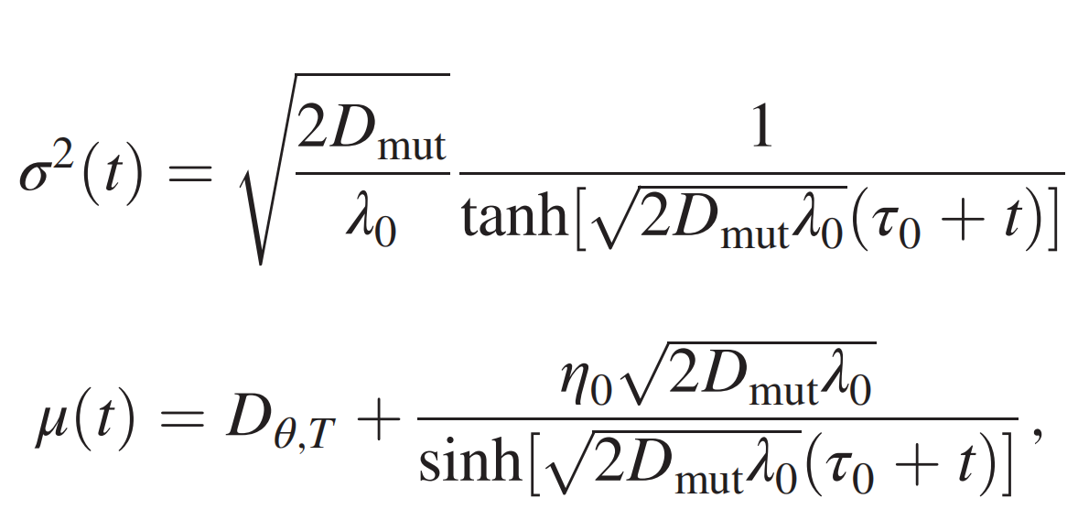
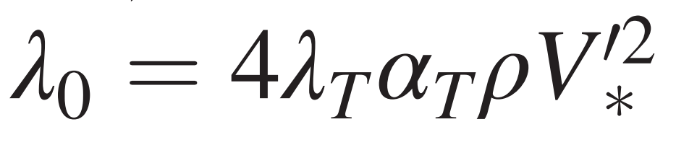
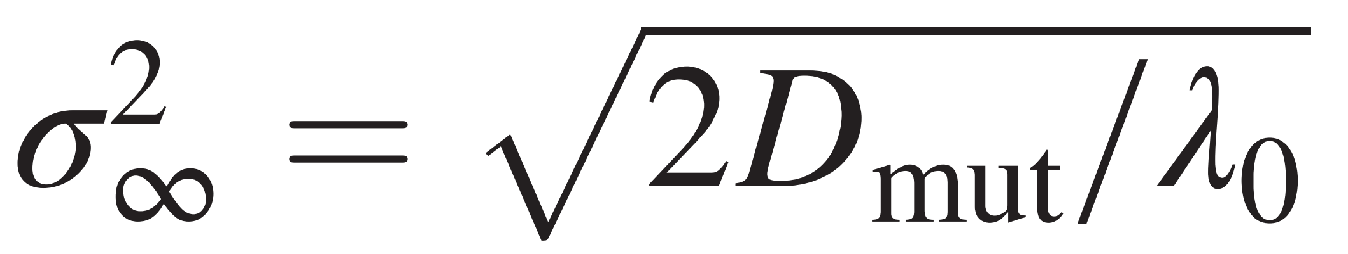
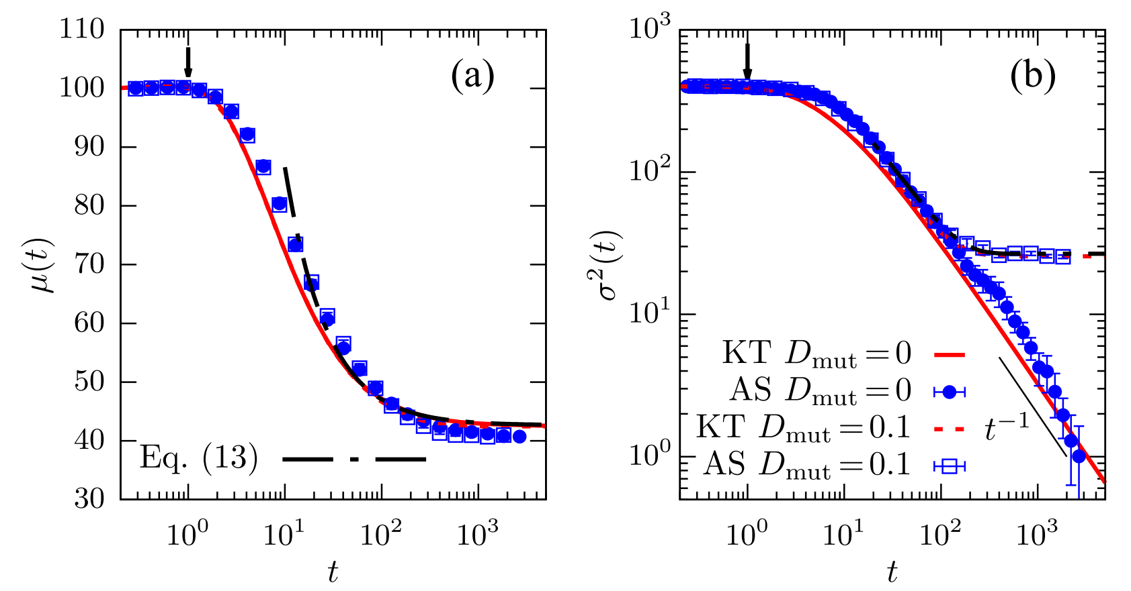
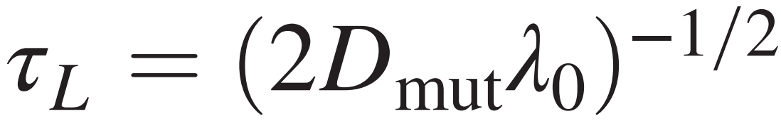
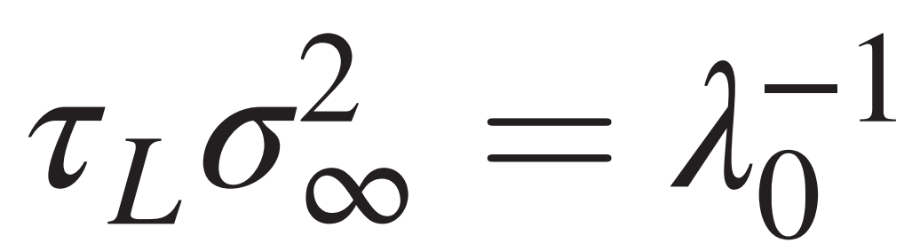
example:Phototactic, diffusive agents
target
equal to
d=2
hydrodynamic equation
characteristic learning rate
steady policy invariance
learning time
uncertainty relation
quick learn is at the cost of large fluctuation around the target policy
or you cannot learn quickly and well at the same learning rate

Slide 12
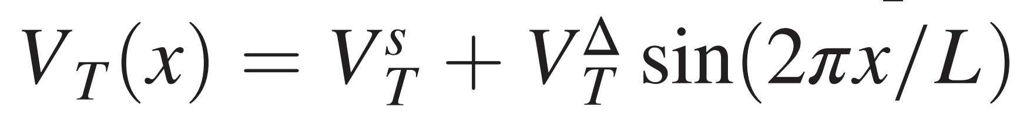
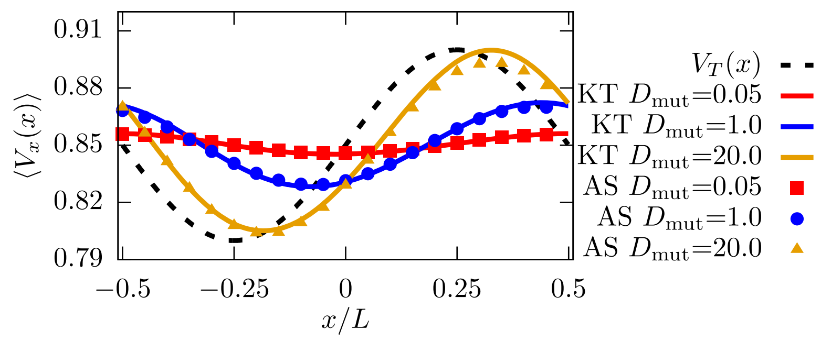
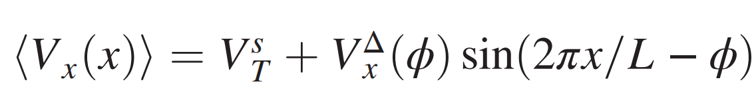
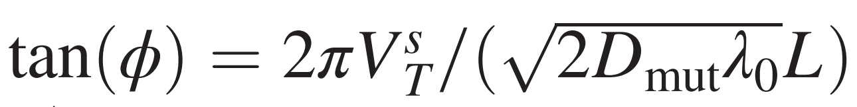
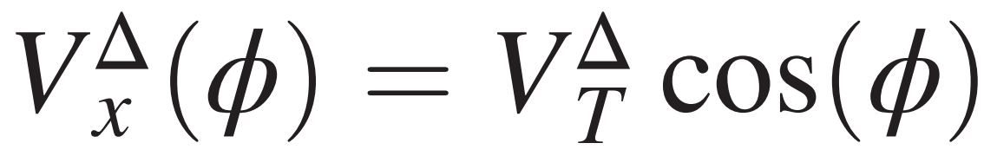
example:Phototactic, diffusive agents
target
steady velocity
Agents with small mutation rates learn too slowly to adapt in time to the environment.

Slide 13
does it machine learning?no
what’s the relationship?

Slide 14
conclusion
kinetic theory framework for decentralized learning in smart active matter
based on the assumption of timescale separation
Microscopic
mesoscopic
macroscopic
uncertainty relation between learning time and policy fluctuations.
“you cannot learn quickly and well at the same learning rate”

Slide 15


Appendix:kinetic theory
derive explicit expressions from microdynamic rules
Continuity Equation​
dynamic rule

Slide 16







Appendix:kinetic theory
transition rate
with kernel
assumption:communication speed ≪motion speed
with

Slide 17




Appendix:kinetic theory
with
.... and depend on model detail
define：
policy’s pdf:
mean memory:
density
mean policy
policy’s invariance

Slide 18
背景介绍

